Slide 1
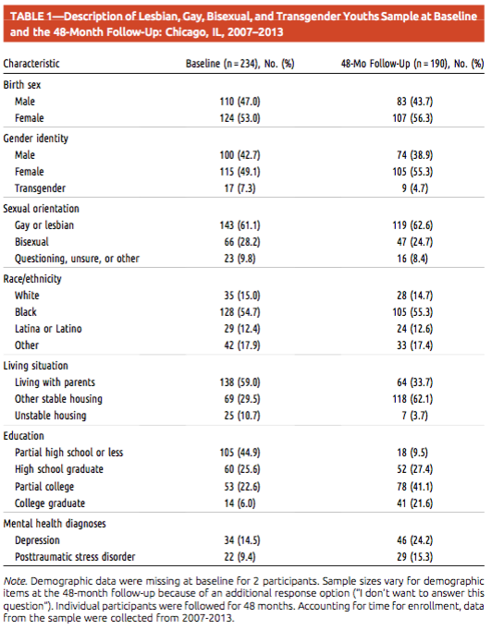
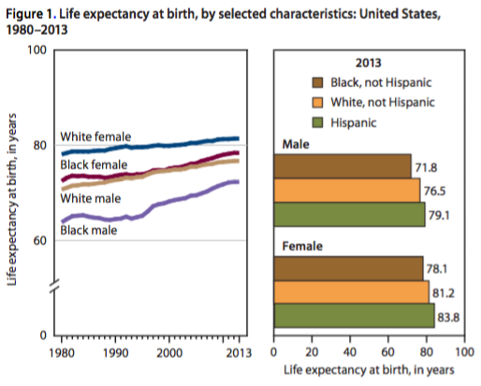
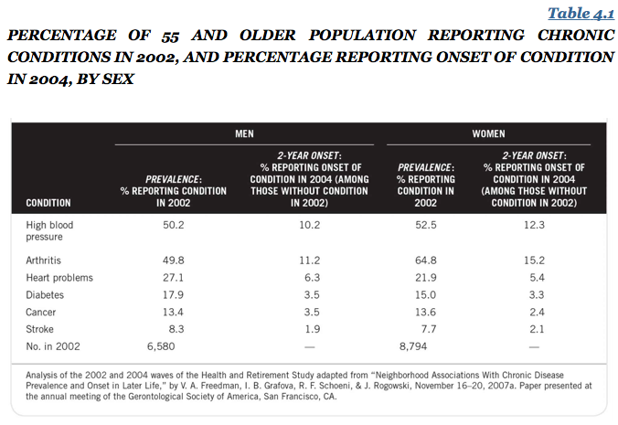
Notes:
examples

Slide 2
Table 2 shows the unadjusted mean physical function scores at baseline by age group and abuse experience. Within each abuse experience category we observed the expected inverse relationship between age and initial mean physical functions scores. Additionally, within each age group initial mean physical function scores tended to be progressively lower among women who had experienced verbal, physical, or both forms of abuse. For example, among women who were between the ages of 50 and 59 at baseline, those who did not experience abuse had a mean PFS of 86, those who experienced verbal abuse only had a mean PFS of 82, those who experienced physical abuse only had a mean PFS of 80, and those who experienced verbal and physical abuse had a mean PFS of 75.
Notes:
compare_01

Slide 3
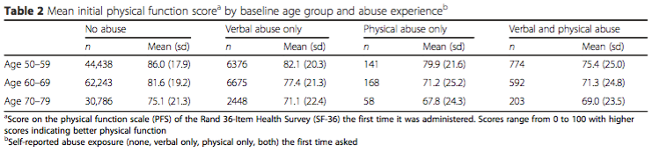
Notes:
compare_02

Slide 4
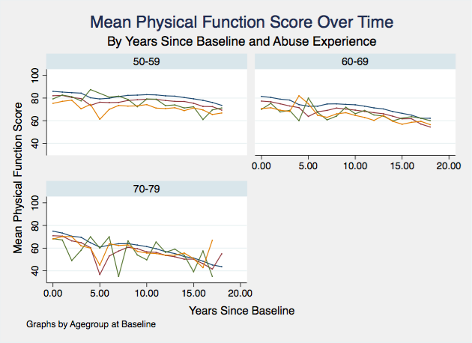

Notes:
compare_03

Slide 5
Table 2 shows the unadjusted mean physical function scores at baseline by age group and abuse experience. Within each abuse experience category we observed the expected inverse relationship between age and initial mean physical functions scores. Additionally, within each age group initial mean physical function scores tended to be progressively lower among women who had experienced verbal, physical, or both forms of abuse. For example, among women who were between the ages of 50 and 59 at baseline, those who did not experience abuse had a mean PFS of 86, those who experienced verbal abuse only had a mean PFS of 82, those who experienced physical abuse only had a mean PFS of 80, and those who experienced verbal and physical abuse had a mean PFS of 75.
Notes:
Compare_04

Slide 6
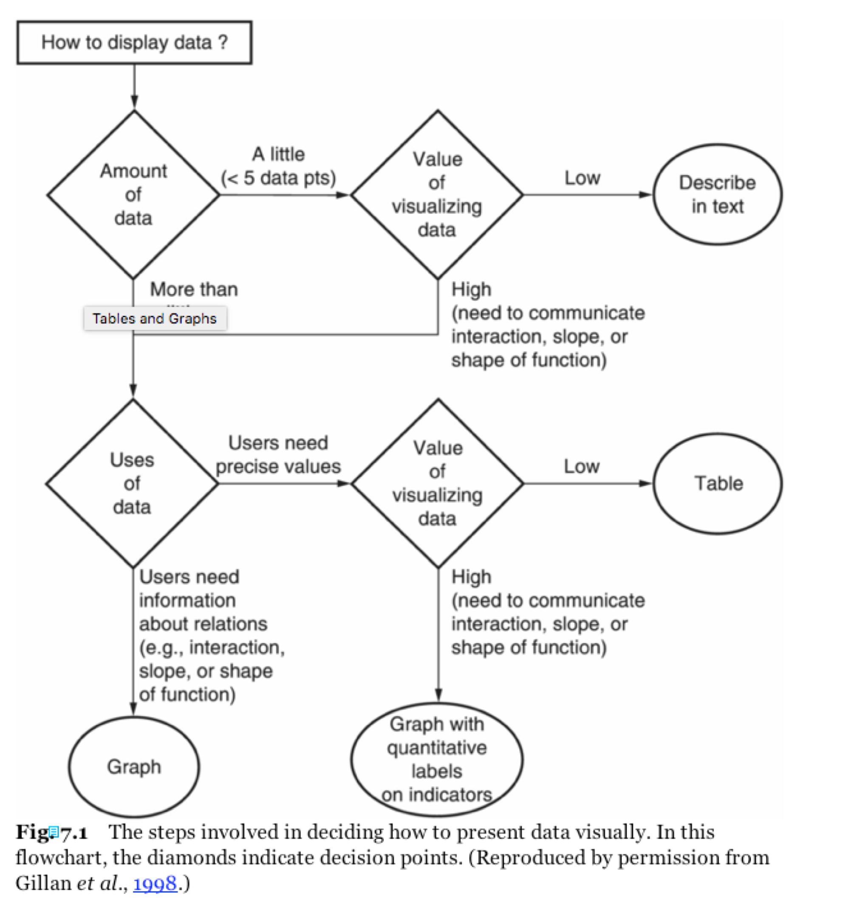
Notes:
flow_chart

Slide 7
References
Matthews JR, Matthews RW. Successful Scientific Writing: A Step-by-Step Guide for the Biological and Medical Sciences. Cambridge University Press; 2014.
Journal Articles

